Slide 1
CV 510 Modeling, Uncertainty, and Data for Engineers (July – Nov 2025)
0
1
Dr. Prakash S Badal

Slide 2
Flow
Announcement
Module Outline
Introduction and Motivation

Slide 3
Announcement
Next week classes
No class on Tuesday (9th Sep)
Wednesday and Thursday (10th and 11th Sep) usual class hours
Additional class on Friday (12th Sep at 8 AM)
Check github regularly

Slide 4
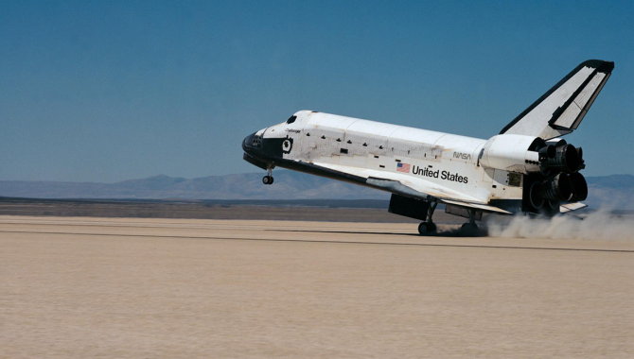
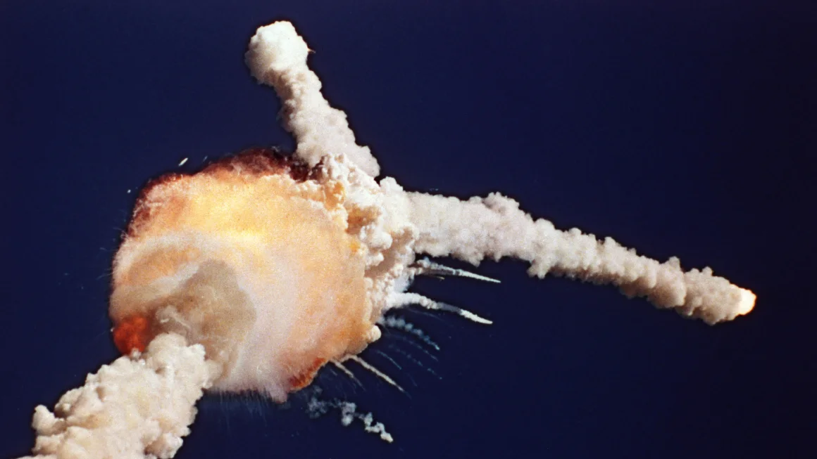
Why should you care about Risk & Reliability?
Space Shuttle Challenger disaster (1986) https://www.youtube.com/watch?v=yibNEcn-4yQ
Catch-all approach:
Build for every “what if” scenario: create backup for every imaginable scenario, even wildly unlikely ones
What could go wrong with this approach?

Slide 5
Why should you care about Risk & Reliability?
Space Shuttle Challenger disaster (1986) https://www.youtube.com/watch?v=yibNEcn-4yQ
Catch-all approach:
Build for every “what if” scenario: create backup for every imaginable scenario, even wildly unlikely ones
Spreads engineers too thin: divided resources, real threats do not get the focus they need
Illusion of safety: looks thorough on paper, but critical risks can slip through because everything is treated as equally important

Slide 6
Module Overview
Propagation laws
Least-squares
Confidence intervals
MLE
Hypothesis testing
Goodness of fit
Uncertainty & Estimation
Random variables
Correlation, covariance
Distributions
Discrete, continuous
PMF, PDF, CDF
Gaussian, uniform, exp, lognormal, Gumbel
Extreme value, return period
Design life
Peak over threshold
Risk and Reliability
Decision analysis
CBA
Risk Analysis

Slide 7
Questions, comments, or concerns?

